Slide 1


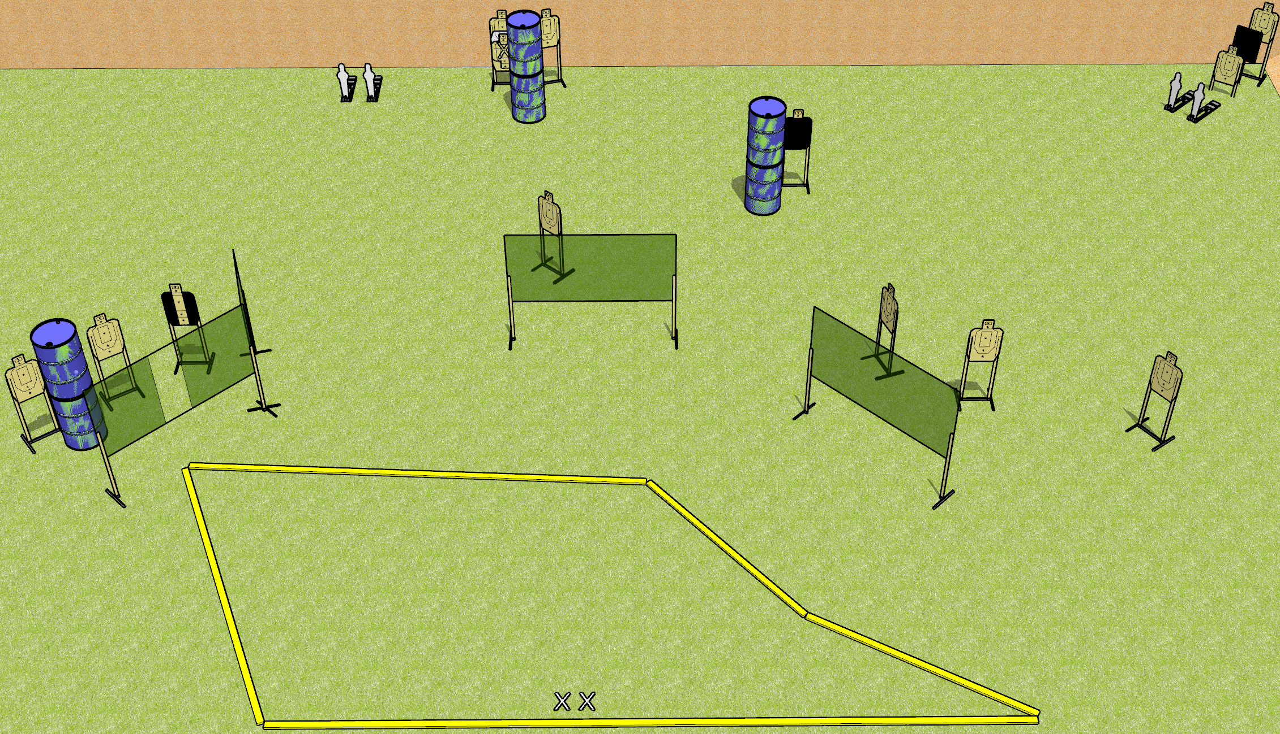
 | Dothan Gun Club – USPSA Match Ping Ping Course Designer : Drew Coleman
Round Count 30 13 USPSA targets 4 USPSA mini poppers
Equipment List 8 wall feet 1 18x24 plate + stand

Slide 2
Ping Ping
Written Stage Briefing
Ping Ping is a 30 round, 150 point, Comstock field course. There are 13 USPSA targets and 4 USPSA mini poppers. The best 2 hits on paper will score, and steel must fall to score. The start signal is audible.
Handgun start position is both feet on X’s, wrists above shoulders. Handgun is loaded and holstered.
PCC start position is both feet on X’s. Loaded carbine is held with both hands, buttstock on belt, safety on.
On start signal, engage targets as they become available from within the shooting area.

